Slide 1
MGT506: Decision Making for Managers CASE 1 Walsh’s Juice Company
GROUP 2
Ishita Agrawal
Nikitha Gokulapati
Nishtha Jain
Fnu Jinson Jiji John

Slide 2
Summary of the Case
Walsh’s Juice Company must transport grape juice from 3 vineyards to 4 processing plants(each plant’s capacity ranges from 1100 to 1400).
The plants produce bottled juice, frozen concentrate, and jelly with different processing costs and capacities.
Each product requires varying amounts of unprocessed juice.
The objective is to minimize transportation and processing costs.
An Integer linear programming model is used to find the optimal solution.
2
MGT506: Decision Making for Managers
CASE 1
Notes:
Product Requirements: Highlight that frozen concentrate requires 2 tons of unprocessed juice per ton of output due to dehydration, while jelly requires 1.5 tons due to water evaporation during cooking. Bottled juice requires 1 ton per ton of output.
Capacity and Constraints: each plant has different capacities (ranging from 1,100 to 1,400 tons) and that the available grape juice supply from vineyards differs each month, adding complexity to the logistics.
Transportation Costs: Emphasize that the cost to transport unprocessed juice varies based on the vineyard-to-plant distances and is a critical factor in minimizing total costs.
Objective: The goal is not only to meet production requirements for each product but to do so at the lowest total cost, factoring in both transportation and production expenses.
Model Structure: Explain briefly that the linear programming model incorporates both logistical (transportation) and production decisions, providing an integrated approach to solve the problem.
Flexibility for Future Adjustments: Note that sensitivity analysis will provide insights into how changes in transportation or processing costs can affect the overall solution, offering opportunities to refine and reduce costs further.

Slide 3
Objective and Question
Objective
The goal is not only to meet production requirements for each product but to do so at the lowest total cost, factoring in both transportation and production expenses.
Question 1
How can Walsh’s Juice Company optimize the transportation of grape juice from vineyards to plants while minimizing total transportation and processing costs?
Question 2
What is the optimal production allocation for bottled juice, frozen concentrate, and jelly at each plant, considering capacity constraints and varying juice requirements for each product?
Question 3
How can sensitivity analysis be used to identify opportunities for further cost reductions by adjusting transportation costs, processing capacities, or product-specific juice requirements?
3
MGT506: Decision Making for Managers
CASE 1

Slide 4
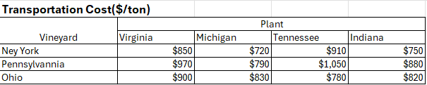
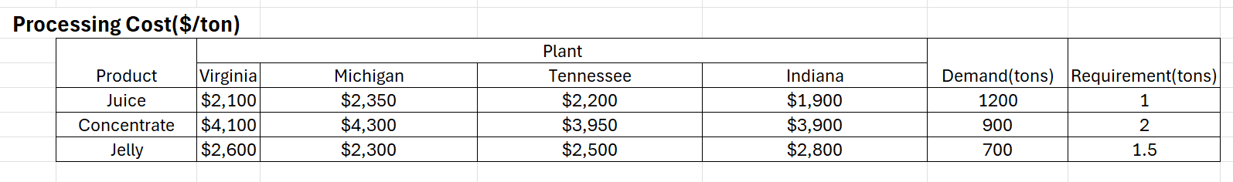
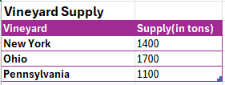
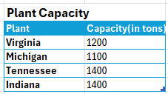
Problem Statement and Data

Slide 5
Model Description
Model Overview:
Integer Linear programming model(Simplex LP) used to optimize the transportation and processing of grape juice.
Objective: Minimize total cost while meeting product demand and plant capacities.
Why This Model:
Handles multiple constraints such as vineyard output, plant capacity, and product-specific processing requirements.
Provides a systematic way to minimize transportation and processing costs while meeting production needs.
Key Assumptions:
Constant transportation costs per ton between vineyards and plants.
Processing cost per ton remains fixed for each plant.
Demand for each product (juice, concentrate, jelly) is fixed.
5
MGT506: Decision Making for Managers
CASE 1

Slide 6
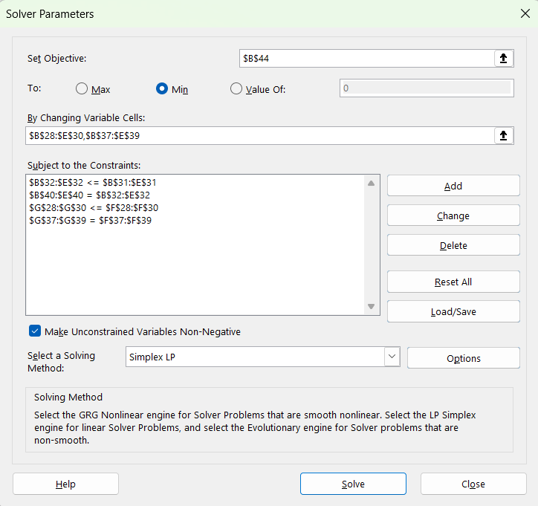
Model Summary
X – Transportation cost
Y – Processing Cost
a,b,c – Vineyards
d,e,f - Products
v,m,t,i - Plants
Minimize Z = $850Xav + 720Xam + 910Xat + 750Xai
+ 970Xbv + 790Xbm + 1050Xbt + 880Xbi
+ 900Xcv + 830Xcm + 780Xct + 820Xci
+ 2100Ydv + 2350Ydm + 2200Ydt + 1900Ydi
+ 4100Yev + 4300Yem + 3950Yet + 3900Yei
+ 2600Yfv + 2300Yfm + 2500Yft + 2800Yfi
Subject To: Xav + Xam + Xat + Xai <= 1400
Xbv + Xbm + Xbt + Xbi <= 1100
Xcv + Xcm + Xct + Xci <= 1700
Xav + Xbv + Xcv <= 1200
Xam + Xbm + Xcm <= 1100
Xat + Xbt + Xct <= 1400
Xai + Xbi + Xci <= 1400
Ydv + Ydm + Ydt + Ydi = 1200
Yev + Yem + Yet + Yei = 900
Yfv + Yfm + Yft + Yfi = 700
Ydv + 2Yev + 1.5Yfv = Xav + Xbv + Xcv
Ydm + 2Yem + 1.5Yem = Xam + Xbm + Xcm
Ydt + 2Yet + 1.5Yft = Xat + Xbt + Xct
Ydi + 2Yei + 1.5Yfi = Xai + Xbi + Xci
And all constraints are non-negative

Slide 7
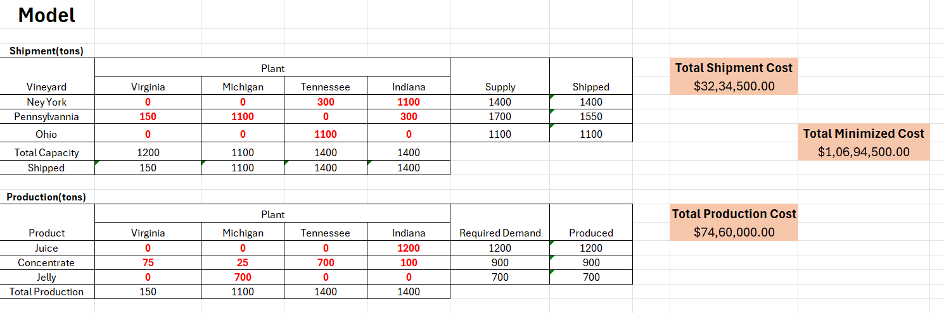
Analysis and Results
The total minimized cost for the Shipment and Production of Grape Juice comes out to be $1,06,94,500.00.

Slide 8
Analysis and Results
The concept used is the Integer Linear Programming Model. This Model help us in providing the whole number as solution which makes it easier to find a feasible solution.
From the Sensitivity report, we notice that the reduced cost is 0 for some of the combinations with the current conditions which won't change the result of optimal solution result.
Example -
Based on the Sensitivity report,
The objective coefficient from Ohio to Michigan =$830
Allowable decrease =$40
Therefore :
Lower Limit of Objective Coefficient = 830−40 = 790
Since the proposed decrease to 780 is greater than the lower limit,
Therefore, the optimal solution remains unchanged.
The report not only help us with finding the feasible solution, It also helps us to compare the factors like cost, allowed increase and decrease range of a product price.
8
MGT506: Decision Making for Managers
CASE 1

Slide 9
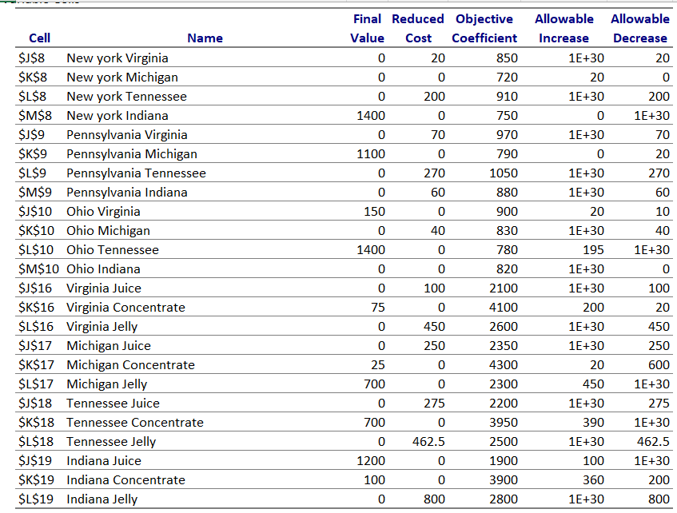
Sensitivity Report

Slide 10
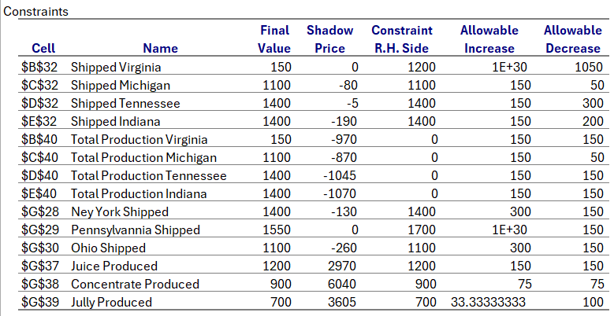
Sensitivity Report Cont.

Slide 11
Conclusion and Recommendation
What are the actions recommended?
Negotiate better transport rates- reduce costs by optimizing transportation routes and cost.
Reallocate production- Shift production to plants with lower processing cost.
Adjust plant capacity- Expand capacity at more cost-effective plants.
Optimize transportation routes- revisit transportation routes to reduce cost from vineyards to the plant.
How Results Support Recommendations?
The Integer linear programming model shows that using the suggested transportation routes and production allocations brings the total cost down to $10,694,500.
By producing more at lower-cost plants and minimizing transport costs, we can save more money.
Sensitivity analysis proves that if we tweak transportation costs or production capacities, we can achieve even more savings. This confirms that the recommended actions are effective for cost reduction.
11
MGT506: Decision Making for Managers
CASE 1

